Slide 1
Lecture-06

Slide 2
Addressing Modes
Immediate
Direct
Indirect
Register
Register Indirect
Displacement (Indexed)
Stack

Slide 3
Immediate Addressing
Operand is part of instruction
Operand = address field
e.g. ADD 5
Add 5 to contents of accumulator
5 is operand
No memory reference to fetch data
Fast
Limited range

Slide 4
Immediate Addressing Diagram
Instruction
Opcode
Operand

Slide 5
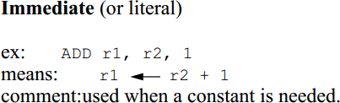
Immediate Addressing
Example : LOAD #5 // AC← 5
Add #7 // AC ← AC+7

Slide 6
Direct Addressing
Address field contains address of operand
Effective address (EA) = address field (A)
e.g. ADD A
Add contents of cell A to accumulator
Look in memory at address A for operand
Single memory reference to access data
No additional calculations to work out effective address
Limited address space

Slide 7
Direct Addressing Diagram
Instruction
Opcode
Address A
Memory
Operand

Slide 8
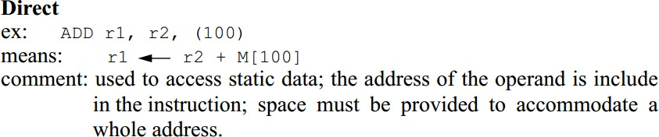
Direct Addressing

Slide 9
Indirect Addressing (1)
Memory cell pointed to by address field contains the address of (pointer to) the operand
EA = (A)
Look in A, find address (A) and look there for operand
e.g. ADD (A)
Add contents of cell pointed to by contents of A to accumulator

Slide 10
Indirect Addressing (2)
Large address space
2^{n} where n = word length
May be nested, multilevel, cascaded
– e.g. EA = (A) or EA=@A Look in A, Find address(A) and look there for operand
Multiple memory accesses to find operand
Hence slower

Slide 11
Indirect Addressing Diagram
Instruction
Opcode
Address A
Memory
Pointer to operand
Operand

Slide 12
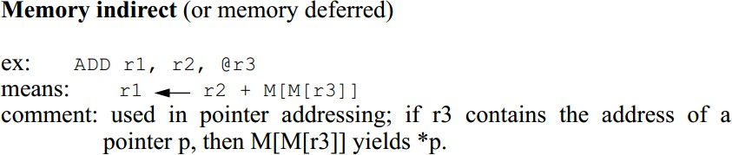
Indirect Addressing

Slide 13
Register Addressing (1)
Operand is held in register named in address filed
EA = R
Limited number of registers
Very small address field needed
Shorter instructions
Faster instruction fetch

Slide 14
Register Addressing (2)
No memory access
Very fast execution
Very limited address space
Multiple registers helps performance
Requires good assembly programming or compiler writing
N.B. C programming
register int a;
c.f. Direct addressing

Slide 15
Register Addressing Diagram
Instruction
Opcode
Register Address R
Registers
Operand

Slide 16
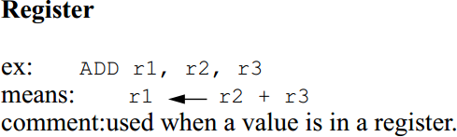
Register Addressing

Slide 17
Register Indirect Addressing
C.f. indirect addressing
EA = (R)
Operand is in memory cell pointed to by contents of register R
Large address space (2^{n})
One fewer memory access than indirect addressing

Slide 18
Register Indirect Addressing Diagram
Instruction
 | Opcode | Register Address R
Memory
Operand
Registers
Pointer to Operand

Slide 19
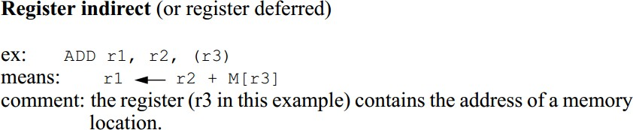
Register Indirect Addressing

Slide 20
Displacement Addressing
EA = A + (R)
Address field hold two values
A = base value
R = register that holds displacement
or vice versa

Slide 21
Displacement Addressing Diagram
Instruction
 | Opcode | Register R |  | Address A
Memory
Operand
Registers
Pointer to Operand
+

Slide 22
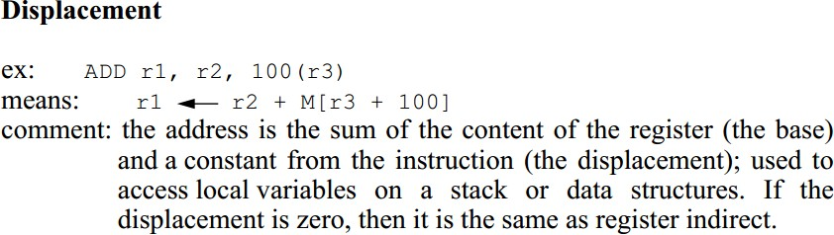
Displacement Addressing

Slide 23
Relative Addressing
A version of displacement addressing
R = Program counter, PC
EA = A + (PC)
i.e. get operand from A cells from current location pointed to by PC
For Example:
Load $A or Load A(PC) // AC← M[PC+A]
Address location is relative to “PC”, this is called Relative Mode.

Slide 24
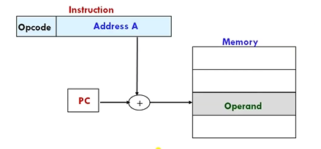

Slide 25
Base-Register Addressing
A holds displacement
R holds pointer to base address
R may be explicit or implicit
e.g. segment registers in 80x86
Register= Base Register
Effective Address = content of BR + address part of instruction
EA = (Ri) + A
e.g. Load A(R1) // R1 ← M[R1 + A]

Slide 26
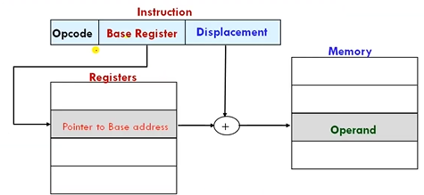

Slide 27
Indexed Addressing
A = base
R = displacement
EA = A + R
Good for accessing arrays
– EA = A + R
– R++
Example: ADD R1, 20(R2) //R1← R1 + M[20+R2]

Slide 28
